Slide 1
Orchestrating Containers:
A comparative Study
Vamsidhar Pagadala, Rohan Athlur, Hari Galla, Adarsha Reddy, Susheel Thimlapur

Slide 2
Contents
Introduction
Application Architecture
Docker Swarm
Kubernetes
OpenShift
Metrics Comparison
Conclusion

Slide 3
Introduction
Container orchestration is essential for modern software engineering, and monitoring and metrics collection is a critical aspect of it.
Docker Swarm, Kubernetes, and OpenShift are among the most popular container orchestration platforms, each with its own strengths and weaknesses
We aim to compare the metrics and monitoring capabilities of these platforms, evaluating their performance, resource utilization, and availability metrics, among others
We hope to provide a comprehensive analysis of each platform's monitoring capabilities and help users make informed decisions when choosing a container orchestration platform

Slide 4
Application Architecture
We have used a sample voting application and the source code can be found in this Github repository
A front-end web app in Python which lets you vote between two options
A Redis which collects new votes
A .NET worker which consumes votes and stores them in…
A Postgres database backed by a Docker volume
A Node.js web app which shows the results of the voting in real time

Slide 5
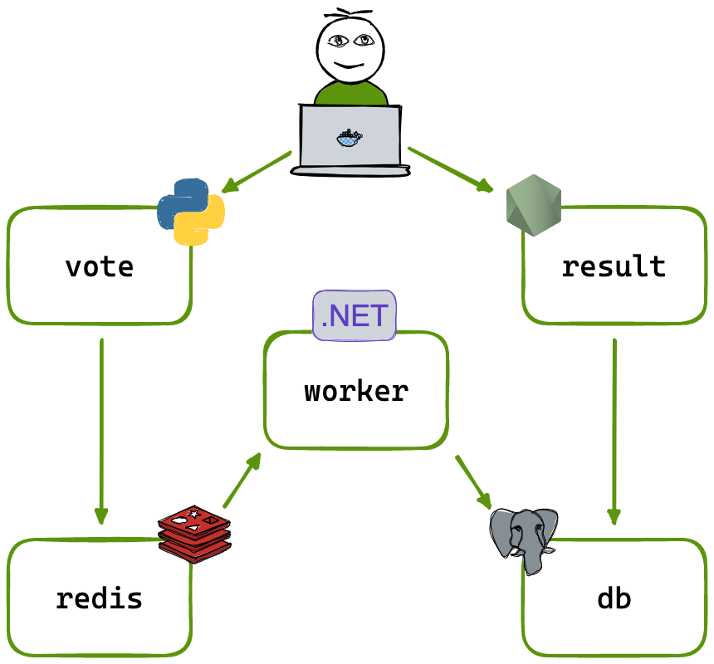
Application Architecture

Slide 6
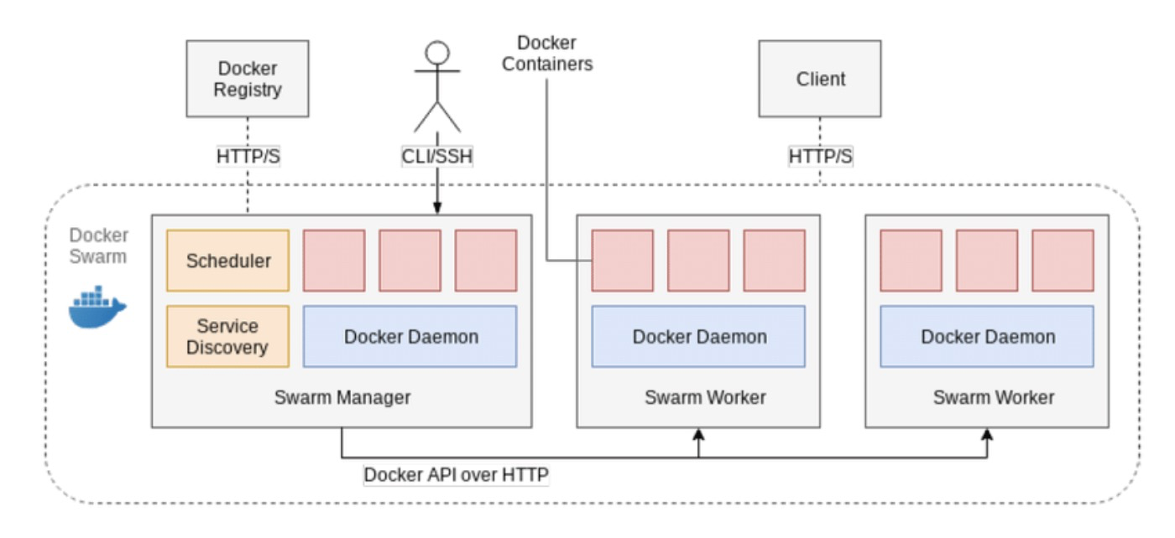
Docker Swarm
Docker Swarm is a container orchestration tool officially from docker that enables the management and scaling of multiple Docker containers across multiple hosts

Slide 7
Swarm Deployment and Monitoring using Swarmpit
Sample Voting application was deployed on a single node Swarm cluster (1 manager)
Docker stack was used to deploy the services required for the application.
Swarmpit; a management interface for Docker Swarm, was deployed into the same cluster to monitor, and manage Docker Swarm clusters and services through a web-based interface.
Load Testing was done using JMeter and Artillery test cases.

Slide 8
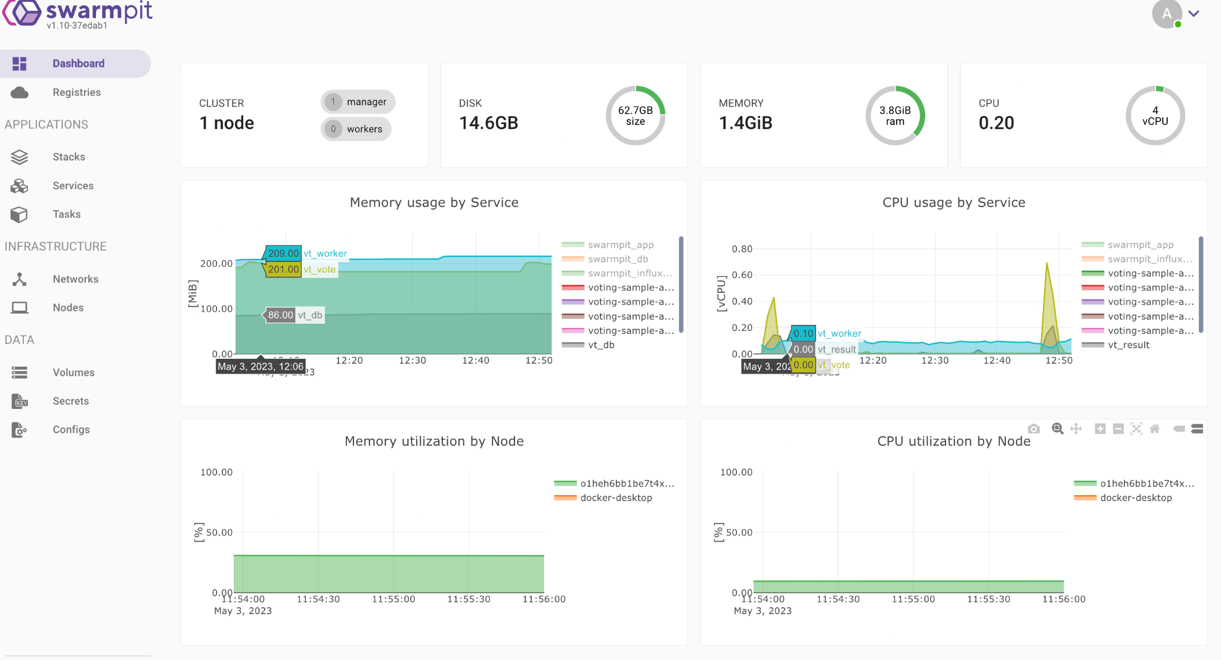
Swarmpit Dashboard Metrics

Slide 9
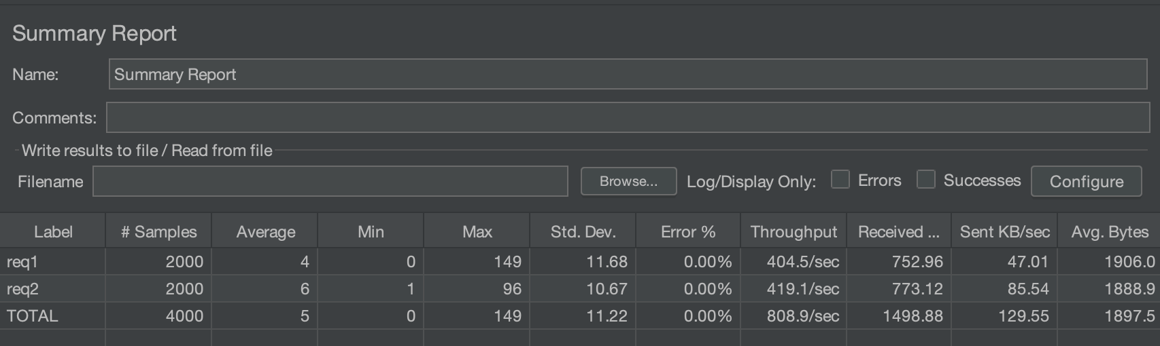
Load Testing Scenario 1

Slide 10
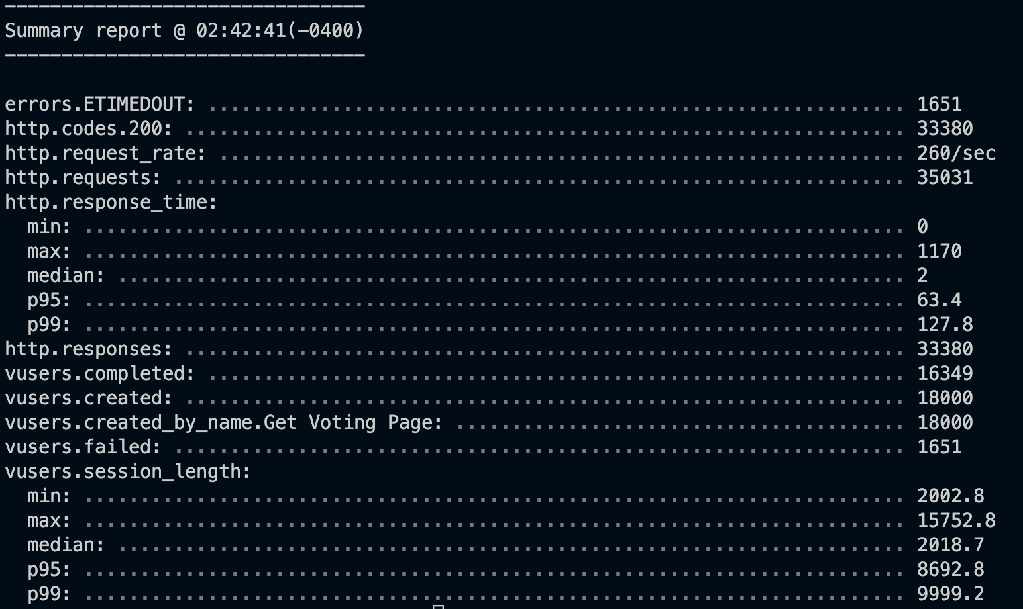
Load Testing Scenario 2

Slide 11
Kubernetes Deployment
Voting application deployed in both single node and multi-node architecture for scalability and high availability.
Prometheus deployed to monitor kubernetes clusters and application performance.
Grafana used to create visually appealing dashboards for metric and log analysis.
Kubernetes dashboard deployed for easy monitoring of CPU, memory and network activity.
Load testing conducted to evaluate application performance and stability by providing pod scalability.

Slide 12
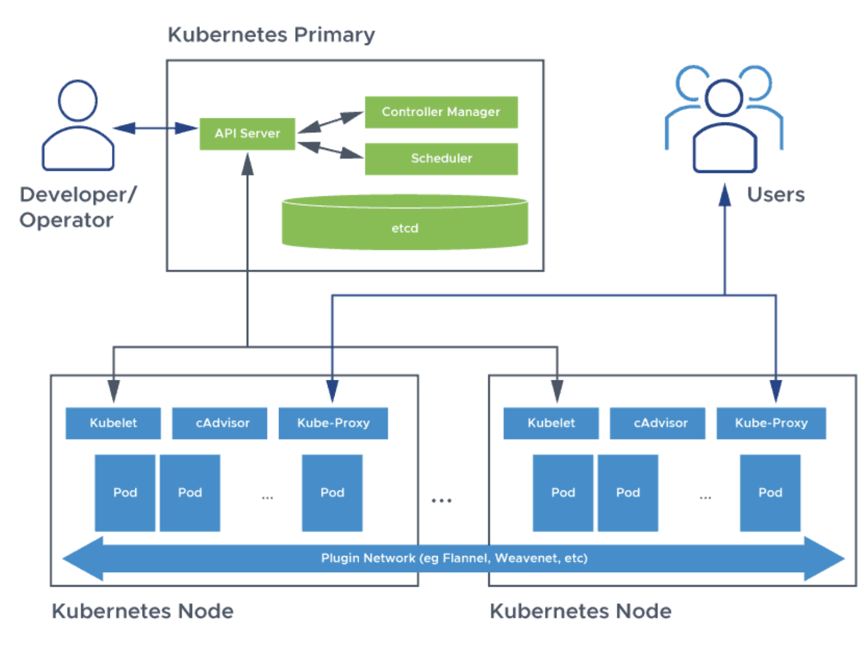
Kubernetes Architecture

Slide 13
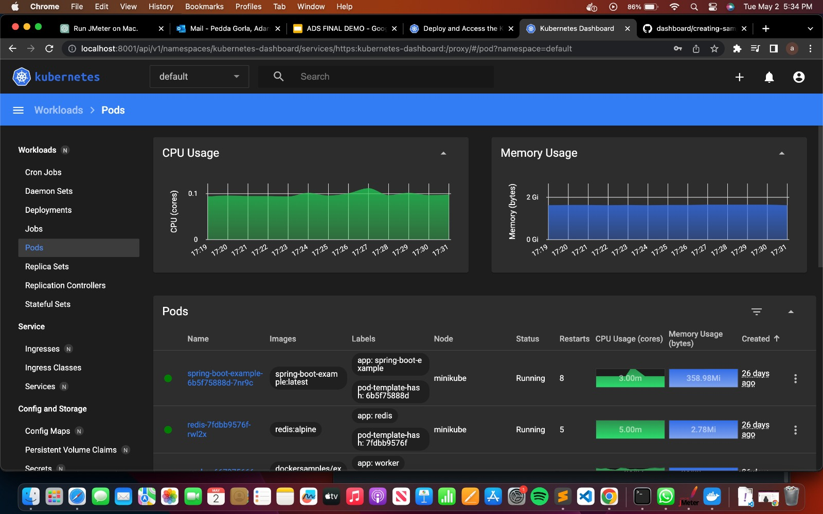
Kubernetes dashboard

Slide 14
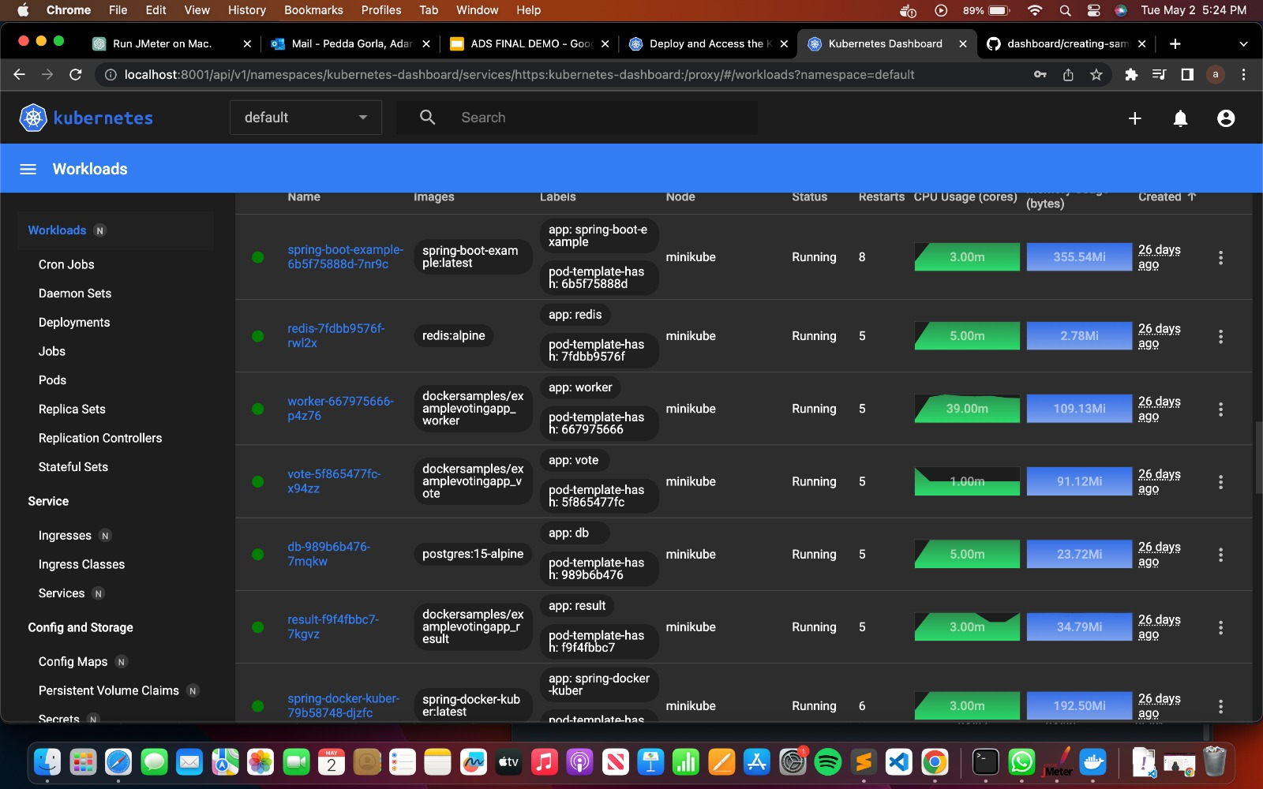
Kubernetes dashboard

Slide 15
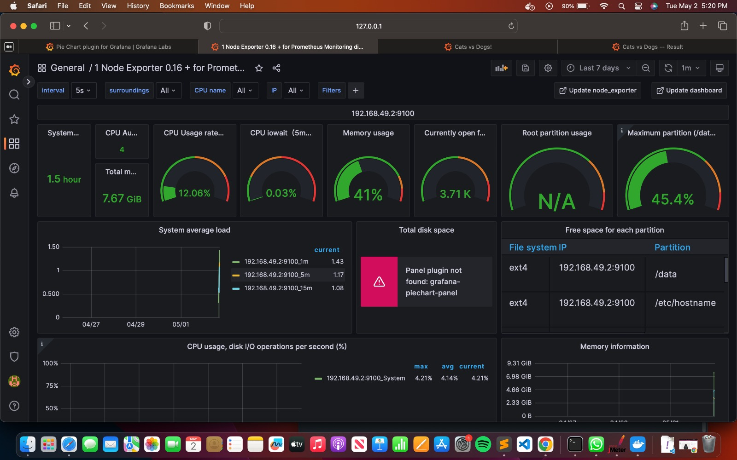
Grafana with Kubernetes

Slide 16
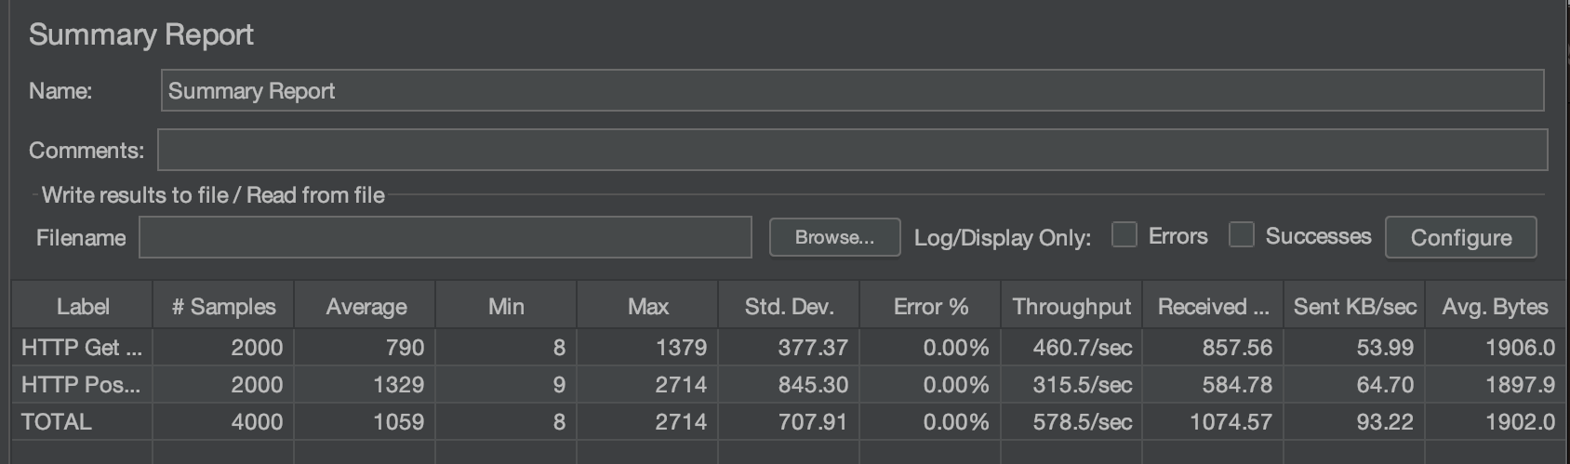
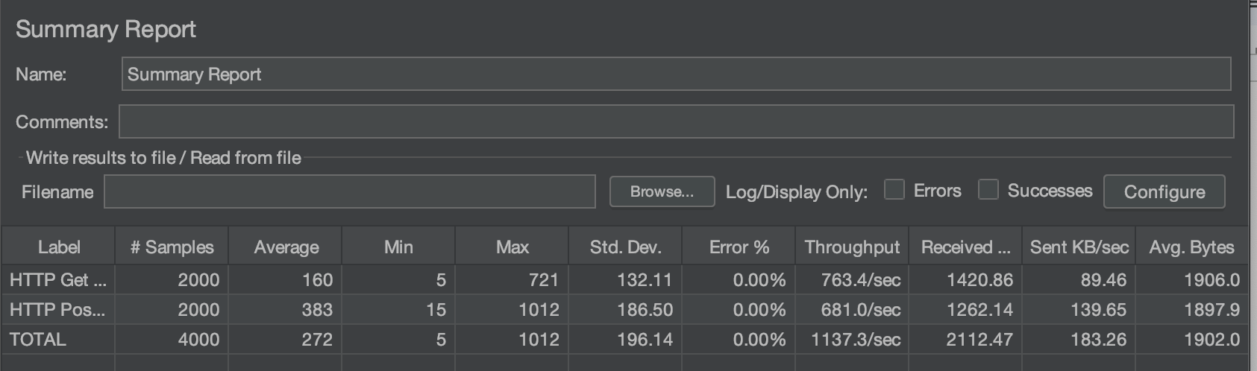
Scenario 1
Single node load testing
Multi-node load testing

Slide 17
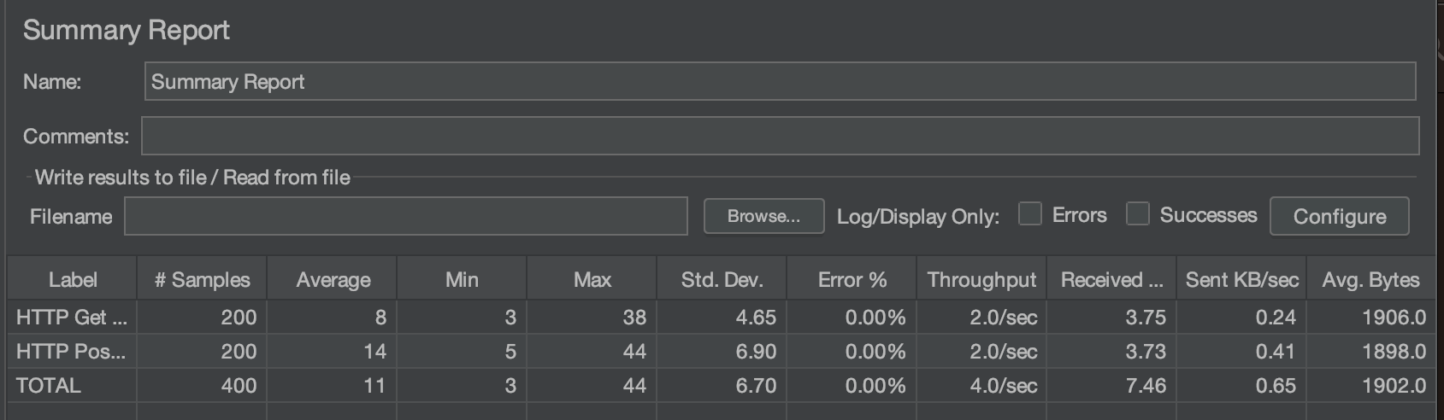
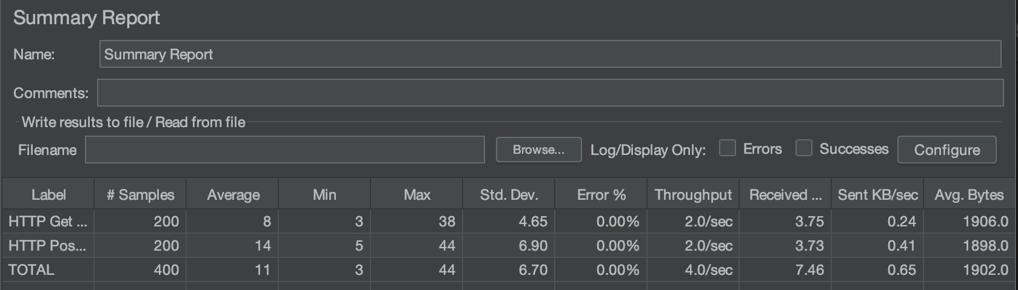
Scenario 2
Single node load testing
Multi-node load testing

Slide 18
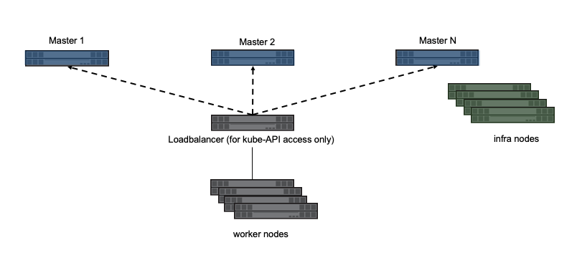
OpenShift
OpenShift Dedicated is hosted and managed by RedHat and provide secure and scalable platform for running containerized applications.
OpenShift Dedicated is a enterprise of kubernetes that provides single-tenant kubernetes environment.

Slide 19
OpenShift Dedicated Deployment
Deployed sample voting application in single node architecture
Observed the CPU, Memory usage using the built-in OpenShift Dashboard
Load testing was done using apache jmeter

Slide 20
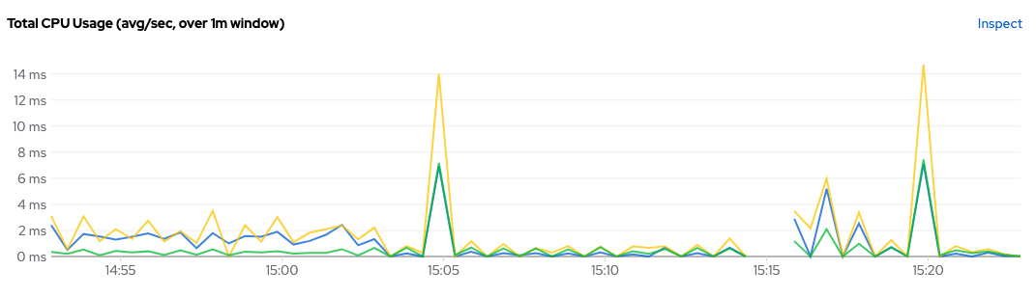
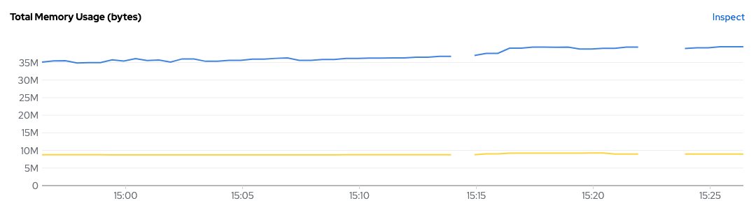
OpenShift Dedicated Dashboard

Slide 21
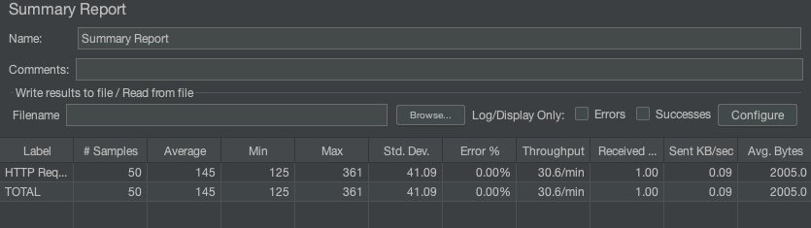
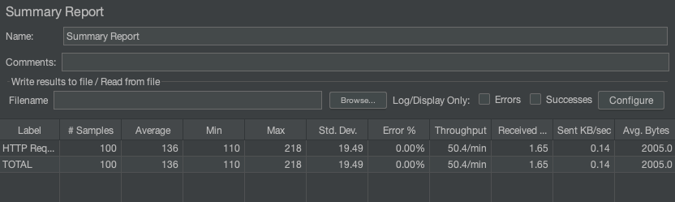
Load Testing
Scenario 1
Scenario 2

Slide 22
Metrics Comparison
 | Docker Swarm | Kubernetes | Open Shift Dedicated
CPU Usage | The least among the three. | Requires higher CPU usage than swarm. | Similar to Kubernetes.
Memory Usage | Pretty much constant through the testing. Lesser than the rest (~35%) | Requires a little more memory compared to docker swarm. (~41) | Similar to Kubernetes. Remains pretty much constant throughout the testing.
Ease of Deployment | Is integrated into native docker environment and is a simple deployment | Complex Deployment | Easy to Deploy using a repository

Slide 23
Fault Tolerance | Basic fault tolerance | High fault tolerance | High fault tolerance
Scaling | Supports automated scaling | Highly scalable with advanced scaling options based on custom metrics | Highly scalable with automatic cluster scaler
Load Balancing | Basic Integrated Load Balancing | Robust Integrated Load Balancing | Robust Integrated Load Balancing

Slide 24
Conclusion
Docker Swarm is a lightweight container orchestration platform
Kubernetes is a more complex and flexible platform with a large ecosystem
OpenShift is an enterprise-focused platform built on top of Kubernetes with additional features and layers of abstraction

